Slide 1
File Management Session 8
Course : COMP6153
Effective Period : September 2018

Slide 2
Sub Topics
The File Management System
File Concepts
File Structures, Attributes and Operations
Directories
Mounting and Sharing
File Allocation Methods

Slide 3
These slides have been adapted from: Stallings, W. (2011). Operating Systems: Internals and Design Principles. 8^{th.} ISBN: 978-0-13-380591-8 Chapter qw
Acknowledgement

Slide 4
Learning Objectives
LO1: Able to describe te concept of File Management
LO2: Relate the file allocation techniques with the current techniques used in O/S
LO 3: Demonstrate different techniques of file allocation method.

Slide 5
File Management System
File management system is considered part of the operating system
Input to applications is by means of a file
Output is saved in a file for long-term storage

Slide 6
Objectives of File Management System (1)
Meet the data management needs and requirements of the user
Guarantee that the data in the file are valid
Optimize performance
Provide I/O support for a variety of storage device types

Slide 7
Objectives of File Management System (2)
Minimize or eliminate the potential for lost or destroyed data
Provide a standardized set of I/O interface routines
Provide I/O support for multiple users

Slide 8
Minimal set of requirements (1)
Each user should be able to create, delete, read, and change files
Each user may have controlled access to other users’ files
Each user may control what type of accesses are allowed to the users’ files
Each user should be able to restructure the user’s files in a form appropriate to the problem

Slide 9
Minimal set of requirements (2)
Each user should be able to move data between files
Each user should be able to back up and recover the user’s files in case of damage
Each user should be able to access the user’s files by using symbolic names

Slide 10
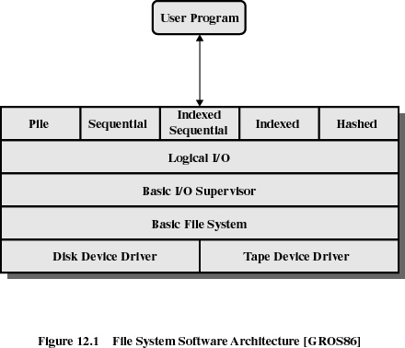
File Management Layers

Slide 11
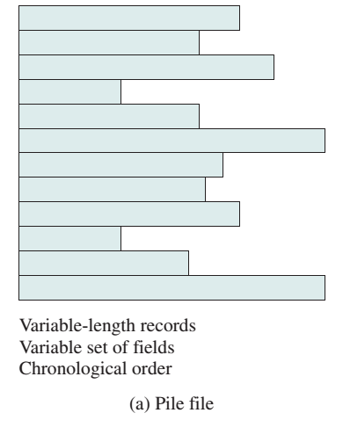
Pile

Slide 12
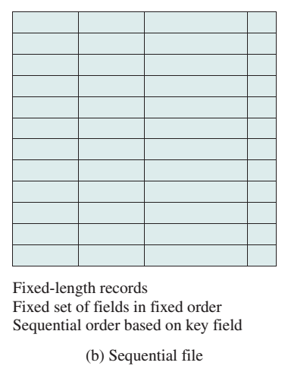
Sequential File

Slide 13
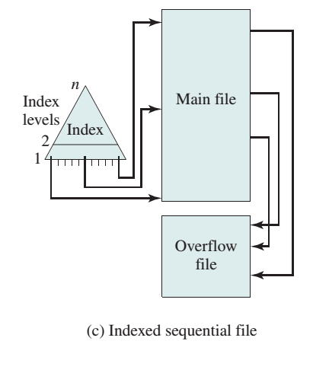
Indexed Sequential File

Slide 14
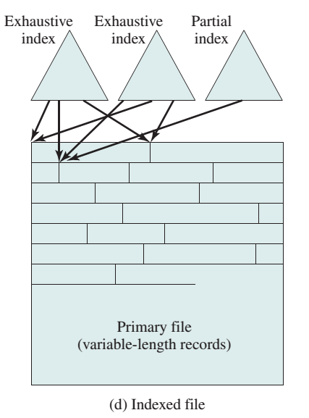
Indexed File

Slide 15
The Direct File (Hash)
Hashing on the key value

Slide 16
Basic File System
Physical I/O
Deals with exchanging blocks of data
Concerned with the placement of blocks
Concerned with buffering blocks in main memory

Slide 17
Long-Term Storage
Requirements for long-term storage:
It must be possible to store a very large amount of information.
The information must survive the termination of the process using it.
Multiple processes must be able to access the information concurrently.

Slide 18
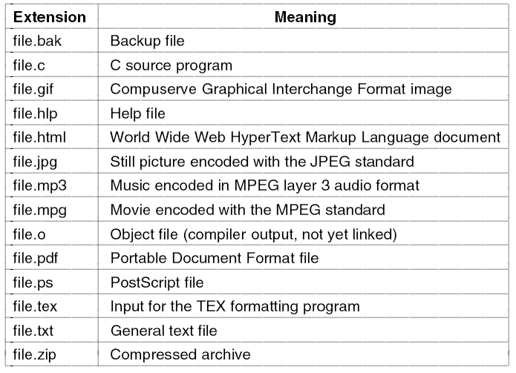
File Naming

Slide 19
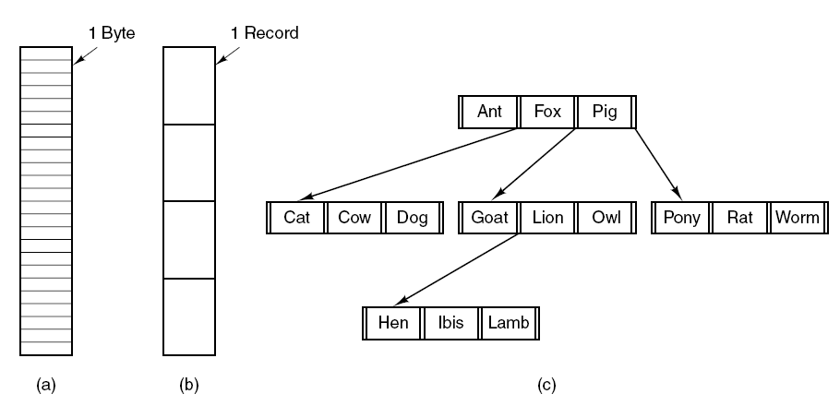
File Structure
Byte Sequence
Record Sequence
Hierarchy

Slide 20
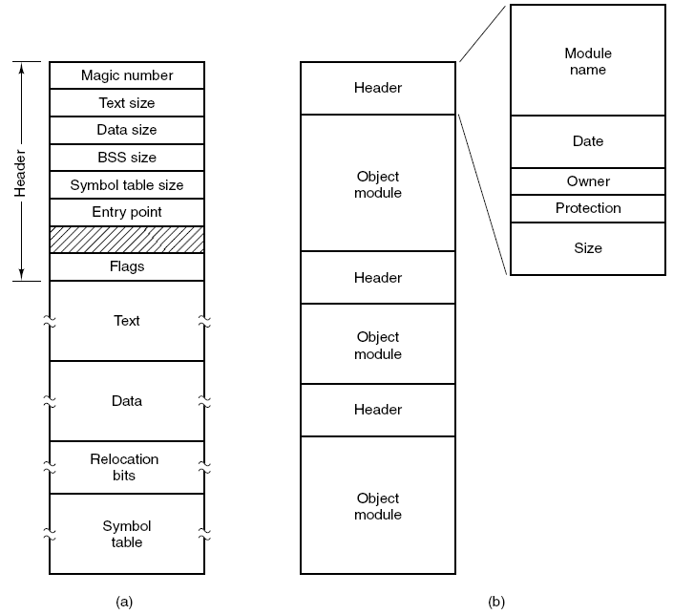
File Types
An executable file.
An archive.

Slide 21
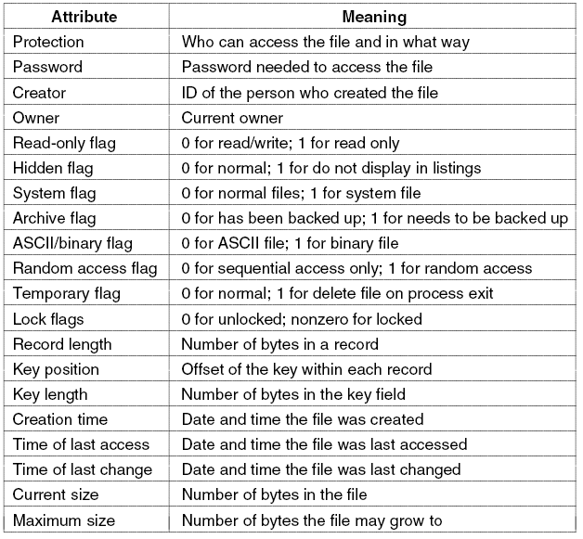
File Attributes (1)

Slide 22
File Attributes(2)

Slide 23
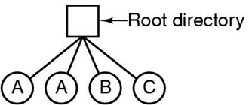
Directories (1)
A single level directory system
contains 4 files
owned by 3 different people, A, B, and C

Slide 24
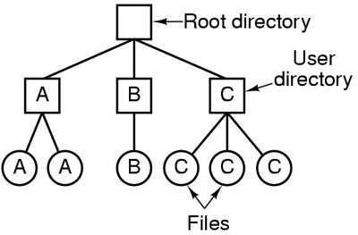
Directories (2)
Two Level Directory System

Slide 25
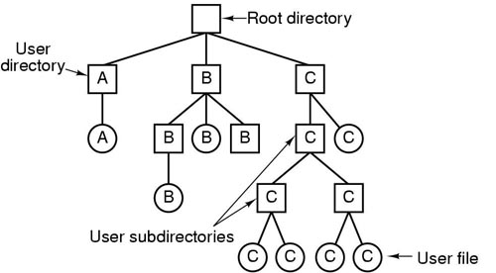
Directories (3)
Hierarchical Directory System

Slide 26
Pathnames
Absolute Pathname
Relative Pathname

Slide 27
File Allocation Method (1)
Contiguous allocation
Single set of blocks is allocated to a file at the time of creation
Only a single entry in the file allocation table
Starting block and length of the file
External fragmentation will occur

Slide 28
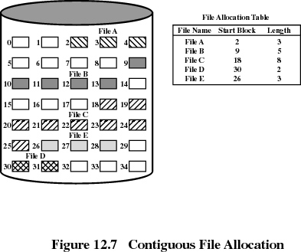
File Allocation Method (2)

Slide 29
File Allocation Method (3)
Chained allocation
Allocation on basis of individual block
Each block contains a pointer to the next block in the chain
Only single entry in the file allocation table
Starting block and length of file
No external fragmentation
Best for sequential files
No accommodation of the principle of locality

Slide 30
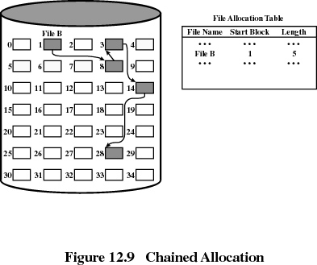
File Allocation Method (4)

Slide 31
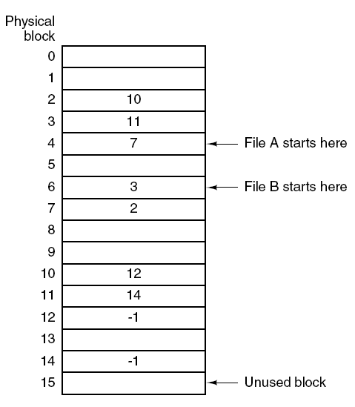
File Allocation Method (5)
Linked List Allocation using Table

Slide 32
File Allocation Method (6)
Indexed allocation
File allocation table contains a separate one-level index for each file
The index has one entry for each portion allocated to the file
The file allocation table contains block number for the index

Slide 33
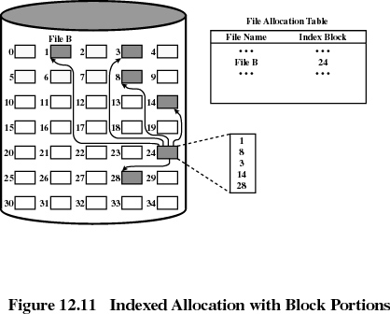
File Allocation Method (7)

Slide 34
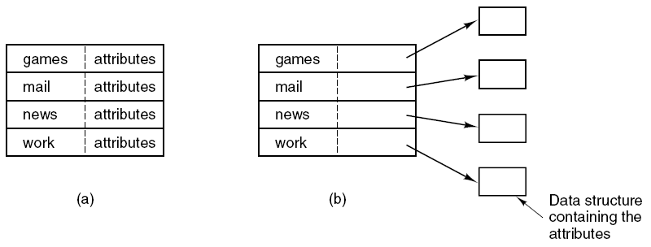
Implementing Directories (1)

Slide 35
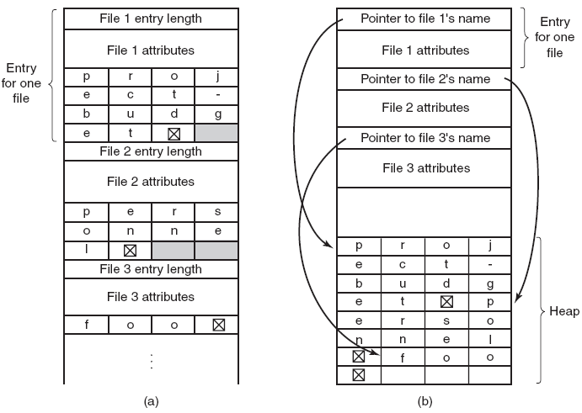
Implementing Directories (2)
Handling Long Filenames

Slide 36
References
Stallings, W. (2014). Operating Systems: Internals and Design Principles. 8^{th.} ISBN: 978-0-13-380591-8
A. Tanenbaum(2007), Modern Operating System, 3rd
ISBN: 978-0136006633

